Slide 1
Paver Mounted Thermal Profiler
By Adam Ross

Slide 2
Outline
What is a Thermal Profile
Why we are interested in it
Where we will be using it
Training before PAIKY

Slide 3
Thermal profiles?
What temperature is the mat really?
Cold spots?
Thermal segregation?
Why do we care?

Slide 4
The Dark Ages
Stick a thermometer in the asphalt in front of paver
IR temp gun
Cook your lunch on the paver

Slide 5
GPS tracking
Know where you are
Speeding bad
Can track equipment, where and what doing
Collect more information

Slide 6
IC
Rollers collecting some temp data
Still limited to one spot every foot
What is the temp across the mat and at the paver?

Slide 7
The IR Bar
First thermal profiler was big and bulky
Large bar across the back of the paver to collect data every foot

Slide 8
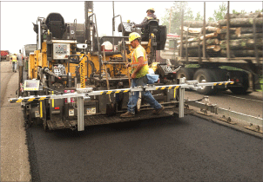
IR Bar

Slide 9
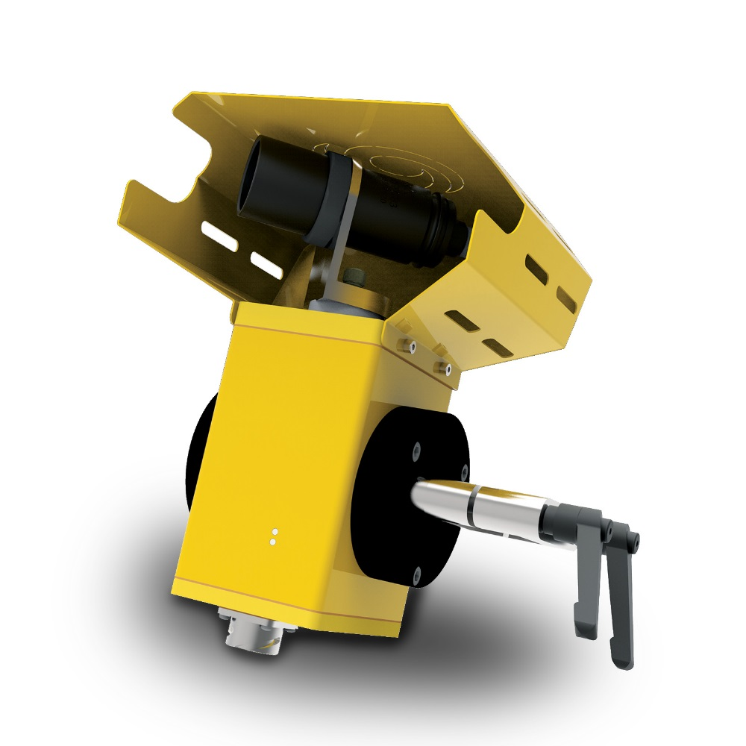
New Design

Slide 10
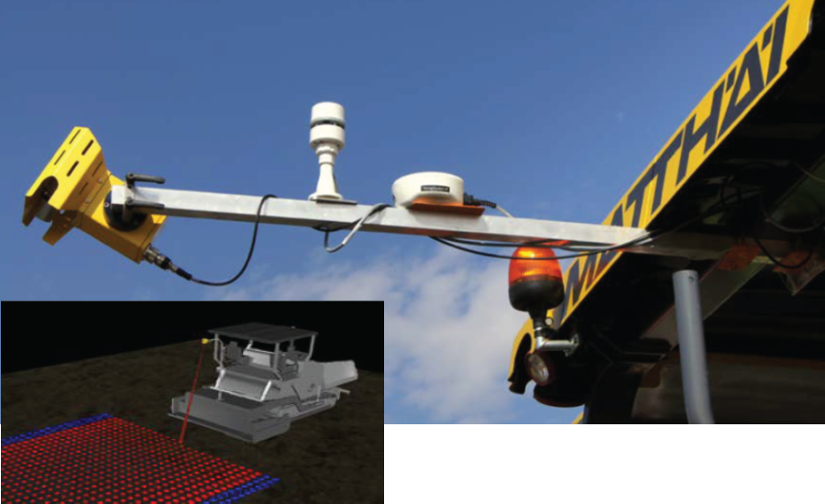
New Design

Slide 11
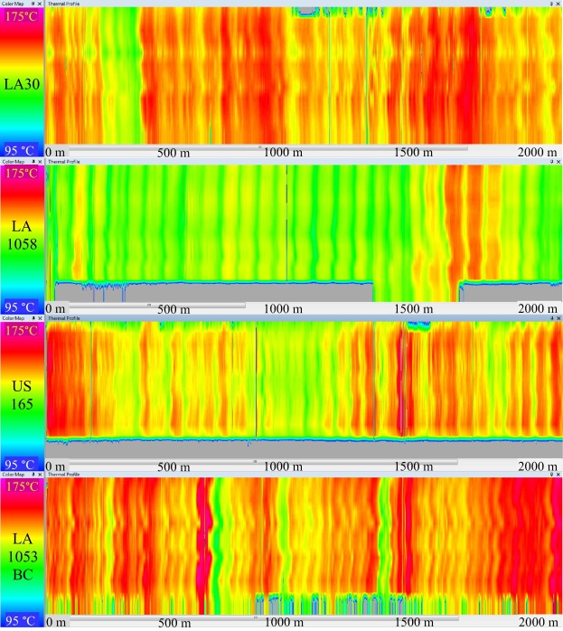
Output

Slide 12
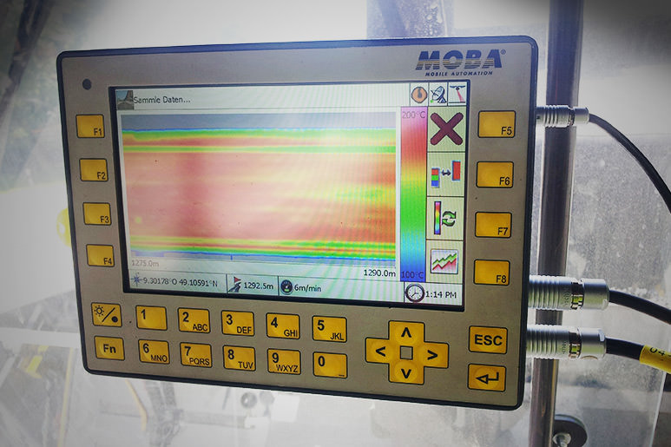
Operator

Slide 13
Training Class
Feb 28 before PAIKY

Slide 14
Several Projects
Jan 2018:
  181003 Perry KY 15 Bypass
  181001 Rockcastle I-75

Slide 15
Projects
December Letting:
  171050 Clay Memorial Drive (KY 2432)
  171259 Webster I-69
  171051 Caldwell I-69
  171053 Hopkins I-69

Slide 16
Projects
October Letting:
  171040 Allen KY 98
July Letting:
  171025 Bell US 119
May Letting:
  171216 Harding I-65

Slide 17
IR+IC
Currently all thermal profile projects are combined with intelligent compaction
Use same eval software VETA
Possibly be expanded out on own

Slide 18
Special note
Specifies the temp range and accuracy
GPS accuracy
Cloud based data system

Slide 19
Profile Data table
(1) Project information including Road Name and Number, PCN, Beginning and Ending MPs.
(2) IR Bar Manufacturer and Model number
(3) Number of Temperature Sensors (N)
(4) Spacing between sensors and height of sensors above the asphalt mat

Slide 20
Profile Data cont
(5) Total number of individual records taken each day (DATA BLOCK)
  (a) Date and Time reading taken
  (b) Latitude and Longitude
  (c) Distance paver has moved from last test location
  (d) Direction and speed of the paver
  (e) Surface temperature of each of the sensors

Slide 21
Coverage requirements
All lanes with at least 85% coverage full pay
All lanes 50-85% coverage pay % covered times the bid amount
  Ex. 60% coverage over 1000 ft, bid $0.10/ SF = 0.6X0.1X(1000X12)= $720
All Lanes <50% coverage no pay

Slide 22
Where to use
Driving lanes, shoulders ramps
Permeant pavement 1.0 inch or thicker
New construction and Rehabs

Slide 23

Questions???

Slide 24
Contact Info
Adam Ross
Geotechnical Branch
502-330-2101
Adam.ross@ky.gov

